Slide 1

How Do Small Habitat Patches Support Higher Biodiversity for an Equivalent Habitat Area?
Erin Ricaloglu
April 9th 2025
Notes:
Hello! My name is Erin Ricaloglu, and I am a thesis student in Dr. Kolasa’s lab. My research focuses on how small habitat patches contribute to higher biodiversity in fragmented landscapes.
Today, I will discuss how I used an ecological modeling tool (NetLogo) to explore the mechanisms behind this question.

Slide 2
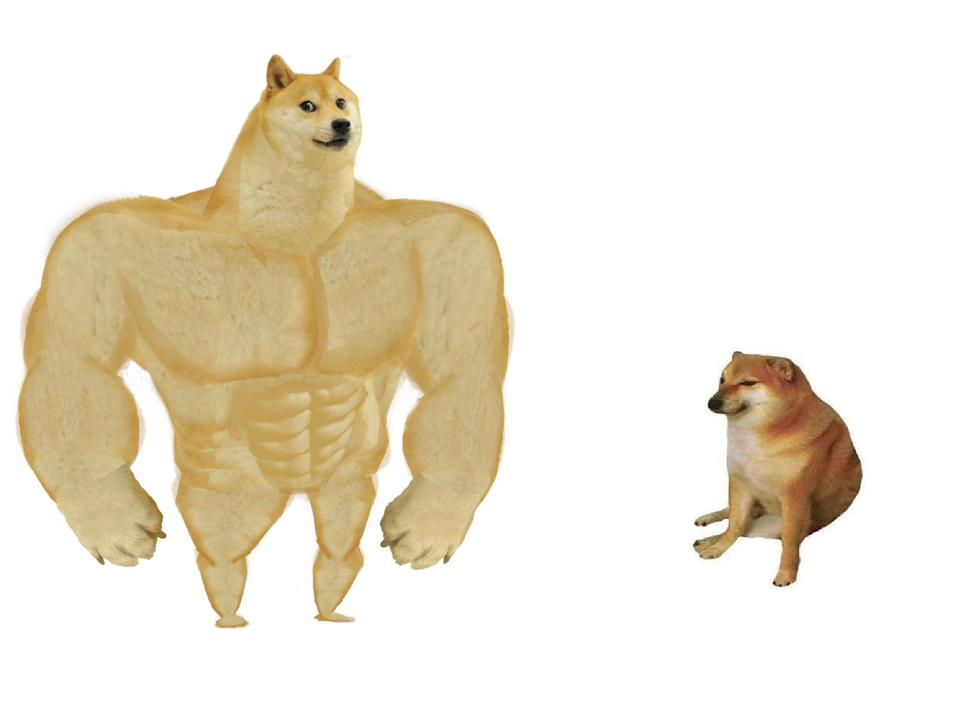

Is bigger really better?
Specialists!
Conventional conservation thinking prioritizes large areas.
Size does matter!
Notes:
Conservation efforts have historically prioritized large, reserves under the assumption that they best support biodiversity.
However, recent research challenges this idea, studies suggest that small patches may act as biodiversity reservoirs as they allow vulnerable species (specialists) to exist.

Slide 3
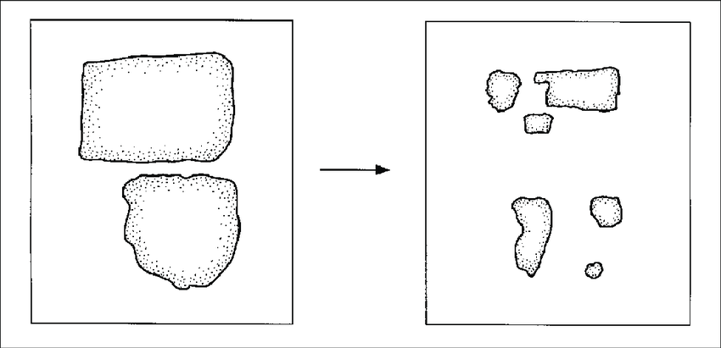
Rethinking Fragmentation
Habitat fragmentation is considered a threat to biodiversity.
Disrupts species movement, reduces genetic diversity and increases extinction risk.
Emerging research (including my own) suggests potential benefits.
Bennett, 2003
Notes:
Habitat fragmentation is often seen as a threat to biodiversity because it disrupts species movement, reduces genetic diversity, and increases extinction risk.
However, despite these negative impacts, some studies, including my own, suggest that fragmentation can yield positive effects, including
increase in connectivity between patches
decrease in intra and interspecific competition.
This raises an important question…..(next slide)

Slide 4
Under what conditions do small and fragmented patches support higher biodiversity?
Notes:
Under what conditions do small and fragmented patches support higher biodiversity?

Slide 5
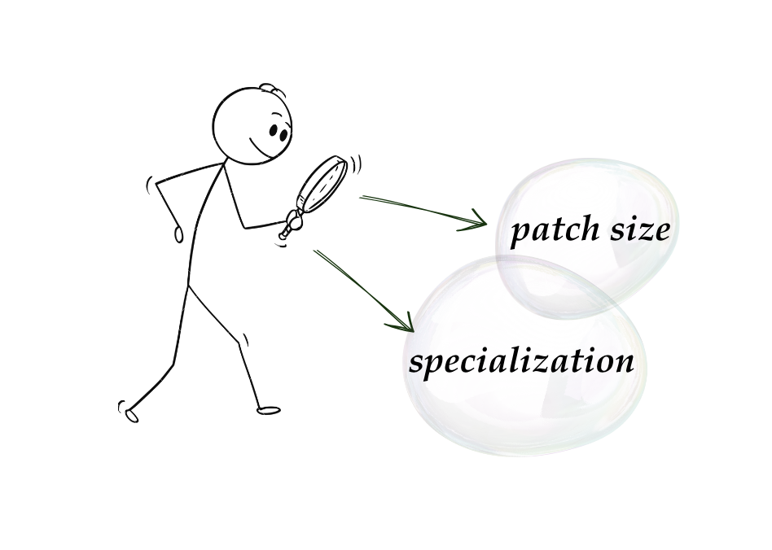
Two Key Perspectives
Notes:
We investigate this question through two key lenses: patch size and species specialization
Examined the patterns they yielded in response to habitat fragmentation.

Slide 6
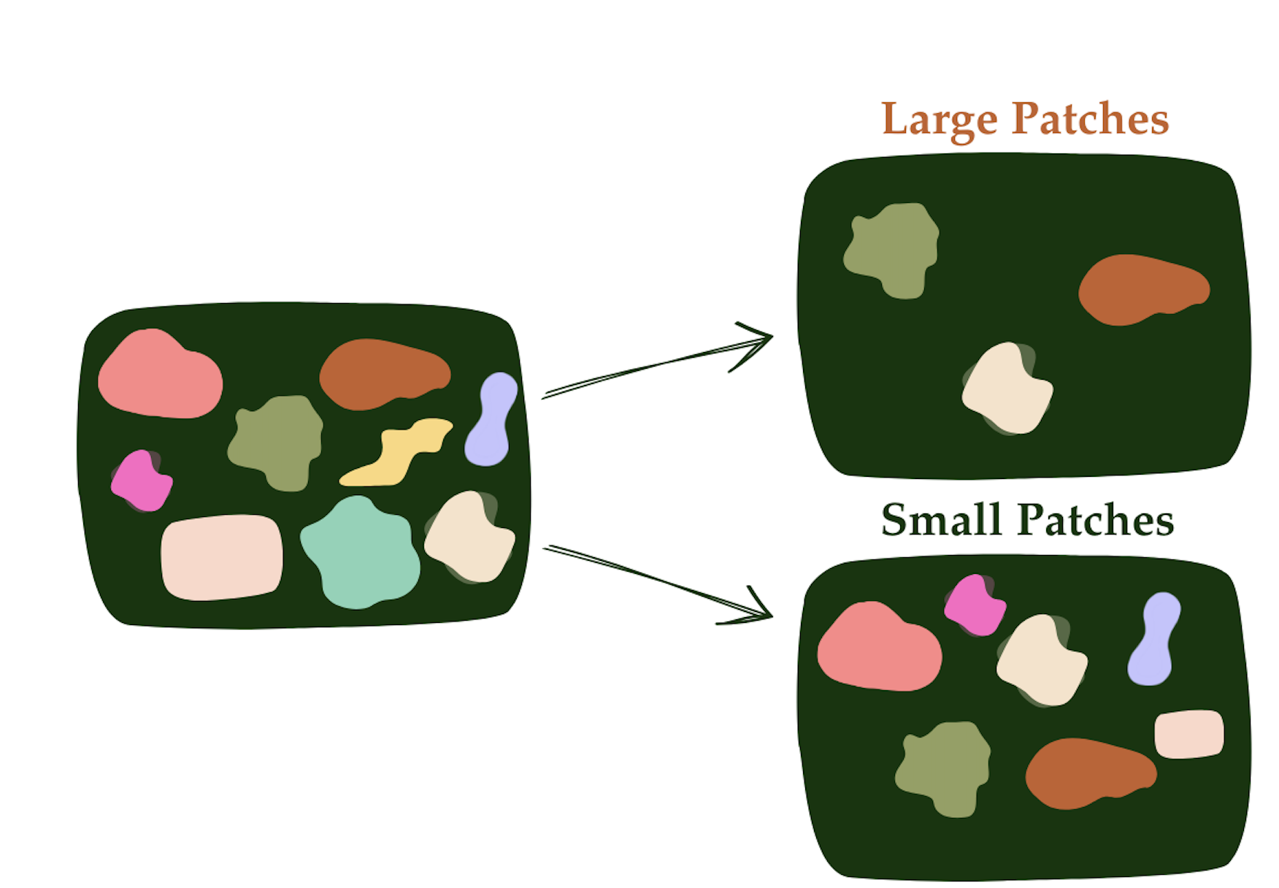
What is a metacommunity?
A network of interacting species distributed across multiple habitat patches.
Connected by dispersal, influencing species composition and turnover.
Notes:
To understand biodiversity in fragmented habitats, we model a metacommunity. Which views species as part of a network across multiple habitat patches, connected by dispersal.
Rather than being confined to one patch, species move, interact, and respond to their environment at the landscape level.

Slide 7
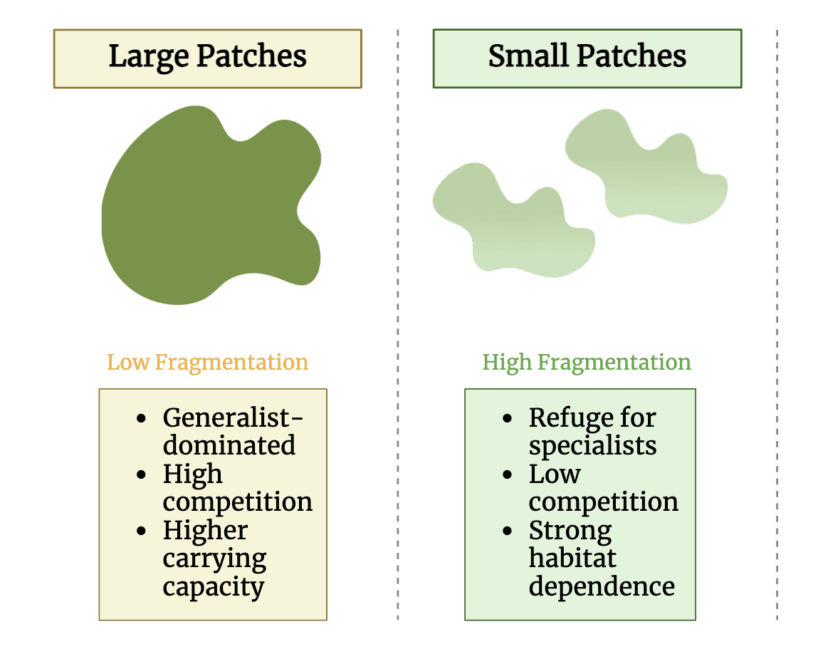
Characteristics of Small vs. Large Patches
BioRender, 2025
Notes:
When discussing patch sizes, there are a few crucial differences amongst them.
Large patches, characterized by low fragmentation, tend to be generalist-dominated due to high competition and a greater carrying capacity.
Meaning they can hold more species, and it is more challenging for specialists to persists.
In contrast, smaller patches have higher fragmentation, offering lower competition. This is an environment specialists prefer.
However, species are constrained by strong dependence on specific habitat conditions.

Slide 8
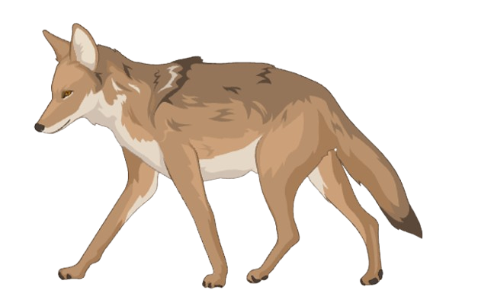
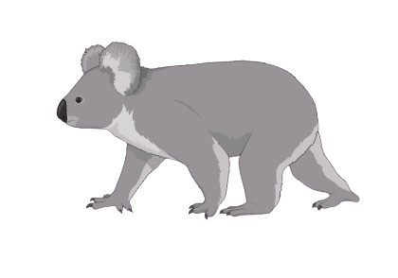
Small patches may act as refuges for specialists.
Generalist
Require specific condition
Lower dispersal
Persist in small patches
Lower reproduction
Thrive in diverse conditions
High dispersal
Dominate large patches
Higher reproduction
Specialist
Notes:
In ecology, designating a species as a specialist or a generalist refers to how much a species depends on a specific diet or habitat.
A classic example of a specialist is the koala, which is highly selective and depends on a limited range of resources for survival.
In contrast, a generalist like the coyote is highly adaptable, thriving in diverse environments—from forests to cities—by utilizing a wide variety of food sources.

Slide 9
Why simulate a fragmented landscape?
Notes:
We used a simulation, as it serves as a computation laboratory; allowing precise control over ecological variables that would take decades to study in the wild.

Slide 10
What Drives Biodiversity in Small Patches?
H1: Small patches enhance biodiversity stability by promoting species sorting, where specialists persist in suitable habitats with reduced competition.
H2: Small patches increase spatial turnover, facilitating species movement between patches and driving community composition shifts over time.
Notes:
To answer our question, we hypothesized that one of these two mechanisms are the answer:
Species Sorting: Specialists persist in small patches because they are filtered into stable niches where competition is lower. In my model, evidence for this hypothesis can derive from lower turnover rates. Essentially, this means their survival is dependent on habitat suitability and their ecological traits.
Increased Spatial Turnover: Small patches maintain biodiversity through frequent species replacement, where ongoing recolonization prevents any single species from dominating. This would show the exact opposite to our first hypothesis, and we predict to see high turnover in smaller patches.

Slide 11
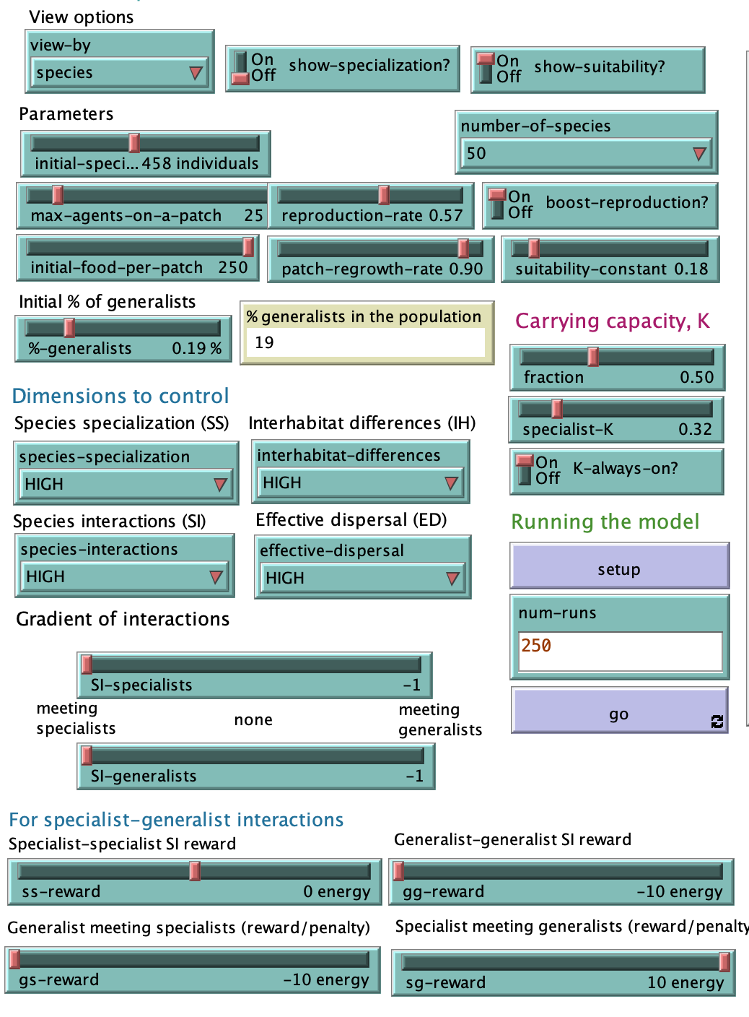
Modeling Fragmented Landscapes: NetLogo
Controlled parameters:
Resource consumption
Species reproduction
Movement
Interactions
Habitat suitability
Run Time: 250 years
NetLogo simulation interface.
Notes:
Here is a screen capture of the Netlogo simulation, showing key model parameters.
The model controls many parameters, in order to keep it as random and neutral as possible, in hopes of simulating a real landscape.
Each patch contains a finite amount of resources. If resources are depleted, species must disperse or face extinction.
Other parameters follow real-world ecological constraints; with differences in reproduction rates according to specialization, and movement that is determined by competition and habitat suitability.
The model simulates interactions amongst generalists and specialists, where species gain or lose energy based on competition.
Each simulation ran for 250 years, with data collected at 50-year intervals to track long-term biodiversity trends and each experiment was replicated 30 times.
In our results, we only display years 2-5, rather than all 5 years. As in the first year of running the simulation, as species are put into the model, there is lots of noise in the results, that do not reflect their behaviour.

Slide 12
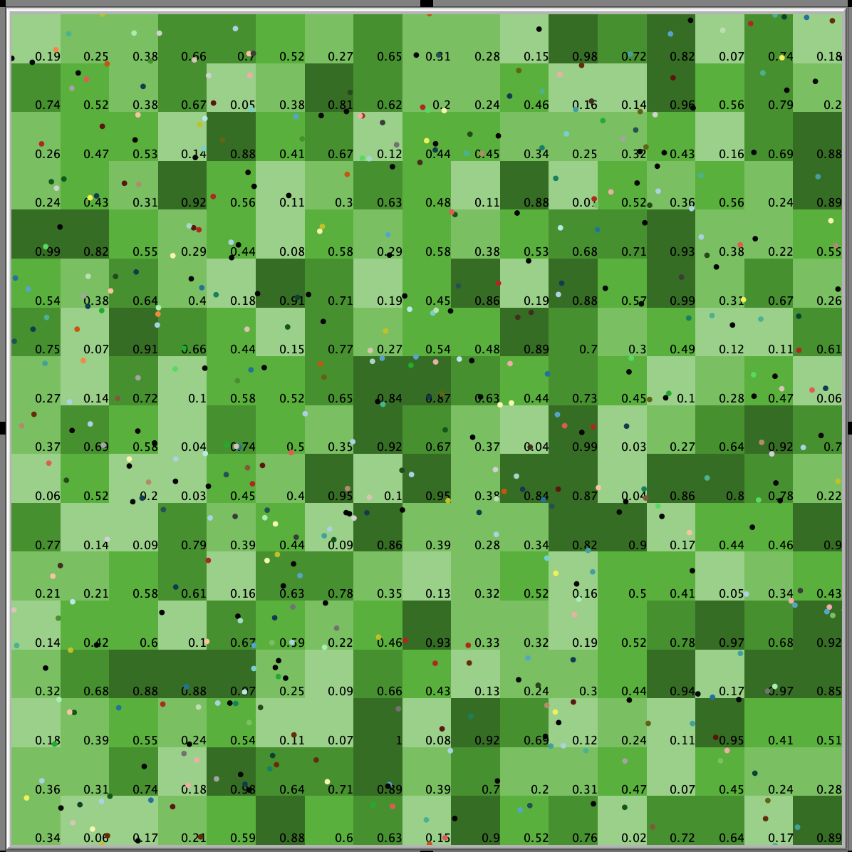
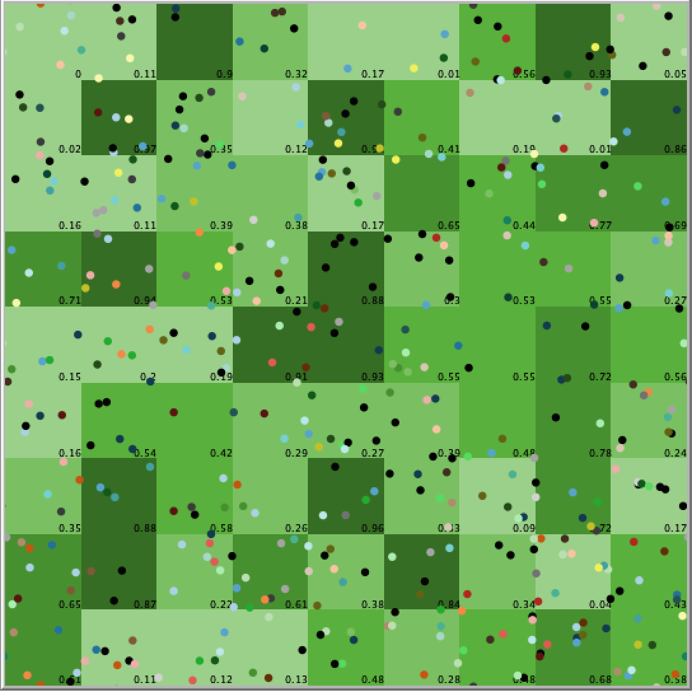
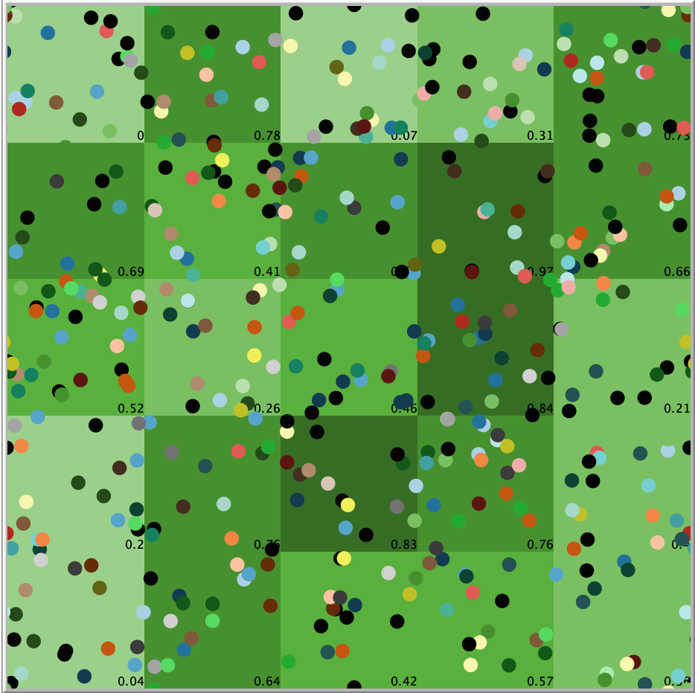
NetLogo Patch Sizes!
Small (289)
Medium (81)
Large (25)
Notes:
Three types of patch sizes were designated to represent different levels of habitat fragmentation: small patches (289) with high fragmentation, medium patches (81) balancing connectivity and isolation, and large patches (25) with low fragmentation.

Slide 13
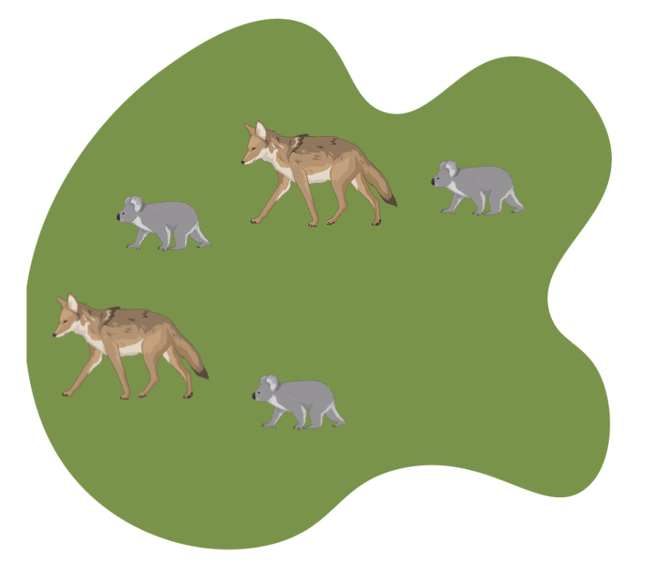
Species Dynamics in Fragmented Landscapes.
How It Works:
Species move based on habitat suitability.
Generalists have the advantage
Extinctions & recolonizations drive species turnover.
Notes:
Species move between patches based on habitat suitability, settling where conditions are best.
Generalists always have the advantage.
Turnover happens as species go extinct in unsuitable patches and recolonize better habitats over time.

Slide 14
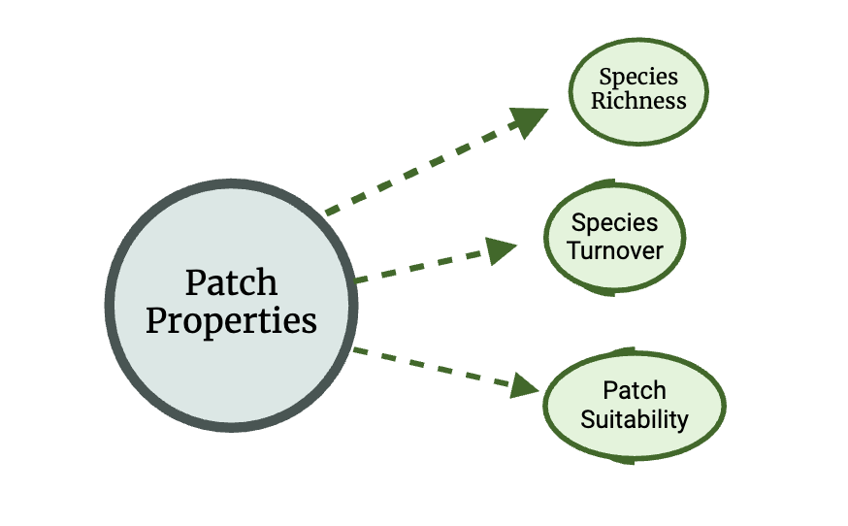
Key Ecological Metrics:
Quantifying diversity over time
Abundance Effects → Relationship between population size & diversity.
BioRender, 2025
Notes:
To quantify biodiversity patterns, I measured biodiversity by tracking species richness, turnover, and patch suitability.
Richness counts # unique species in a patch
Turnover shows how often species composition changes
Suitability determines whether a patch favors specialists or generalists, shaping long-term persistence.
With these metrics, we can visualize the relationship btwn size and diversity.

Slide 15
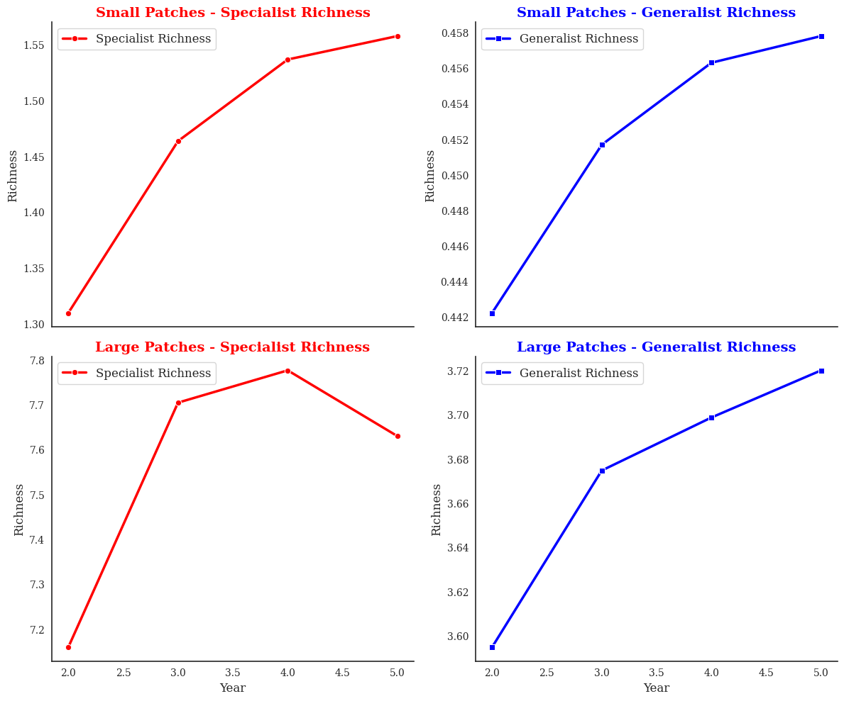
How Habitat Size shapes Species Richness
Species richness was nearly double in small patches compared to large patches.
Support for Hypothesis 1
Notes:
Our first set of graphs show that small patches supported nearly twice the species richness of large patches.
The graph shows the year, taken from our Netlogo model compared to species richness. This was a predicted result.
The left side visualizes specialist richness in both small and large patches.
The top (left) graph shows specialists thriving in smaller patches (due to less competition and stable habitats )
In large patches (bottom left), specialists face strong competition and cannot persist past a certain point.
The right side shows generalist richness.
In both small and large patches, generalists expanded their growth.
This confirms that small patches better support specialist persistence, and large patches seem to favour generalists

Slide 16
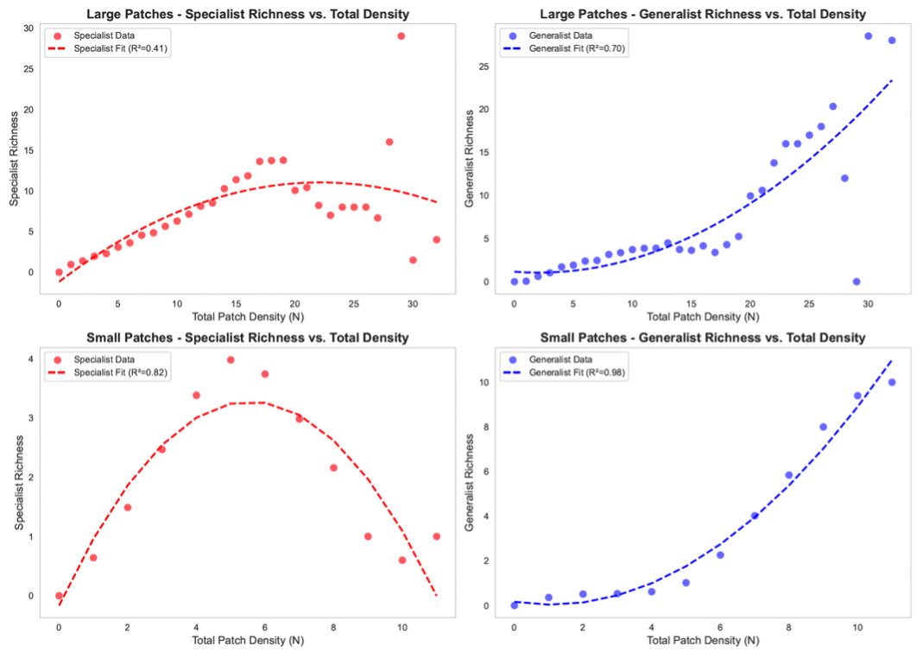
Competitive Interactions Shape Species Richness
Specialists thrive in small patches but decline when generalists are introduced.
Generalists dominate large patches, but high total abundance leads to density-dependent limitations on their growth.
Notes:
The second set of graphs details that specialists particularly decline in small patches, once generalists populate.
These graphs compare total patch density (which is total abundance) and species richness.
On the bottom, we see small patches. (POINT)
Specialists (bottom left) follow a unimodal trend —initial success, then decline at high densities due to competition
Generalists (bottom-right) steadily increase with density, showing a near-perfect positive correlation
On the top there are the large patches.
Specialists (top left) exhibit no clear pattern, they continue to struggle to establish stable populations.
Generalists (top right) dominate, however a bit of their growth is slowed at higher densities.
We continue to observe that generalists can out-compete and dominate specialists in both patch sizes. Suggesting that competition is an influencing factor in species persistence, rather than dispersal.

Slide 17
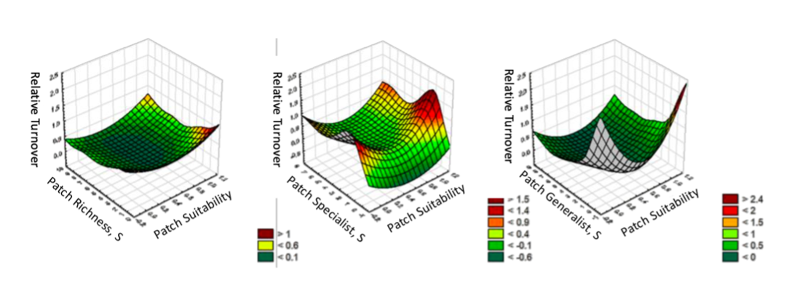
Small Patches act as Ecological Filters
Stable turnover in small patches
Generalists struggle in high-quality habitats dominated by specialists.
Notes:
Further, these graphs show how patch richness, habitat suitability, and turnover relate to biodiversity stability. All 3 graphs show small patch results.
The x axis compares patch richness to y axis patch suitability, and the z axis is relative turnover, which can be easily visualized by the color gradient.
Color gradient: Red/orange = high turnover (unstable), Green = low turnover (stable).
Left graph (all species): Biodiversity is most stable at moderate richness.
High turnover in high-suitability patches reinforces that competition drives species replacement.
This shows very stable compositions when species are sorted into suitable patches.
Middle graph (specialists): Specialists thrive in optimal conditions but experience high turnover in unsuitable habitats, suggesting habitat filtering.
Right graph (generalists): Generalists show high turnover at both low and high suitability, meaning they are adaptable but may struggle in specialist-dominated environments.
Supports Hypothesis 1: Small patches stabilize biodiversity by filtering species into suitable habitats rather than relying on species turnover.

Slide 18
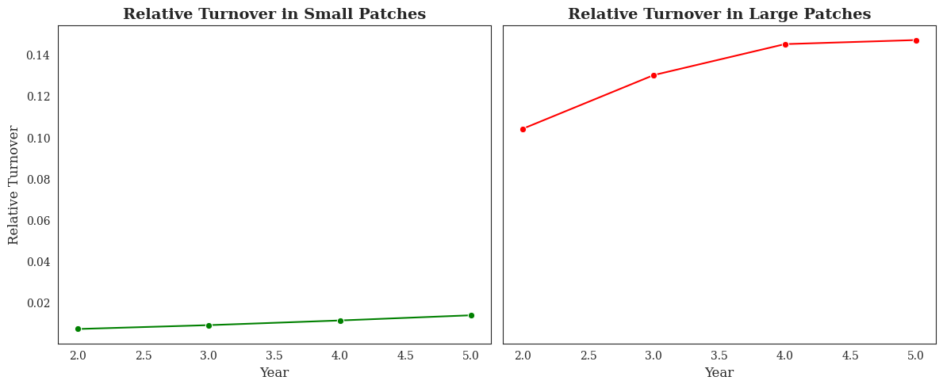
Stability in Small Patches, Species Loss in Large Patches
Large patches exhibit higher turnover.
Notes:
My final sets of graphs show that large patches have twice the turnover of small patches.
Turnover increasing over time in large patches, means that more species were lost.
This matches with our results that species richness was double that in small than in large.
As small patches also have stable turnover, we see that species compositions do remain more constant. This means reduced competition prevents species loss, and buffers specialists from extinctions.

Slide 19
The Power of Species Sorting
Small patches promote species sorting, leading to stable specialist populations and reduced turnover.
Stepping-stone networks prevent local extinctions and support long-term biodiversity.
Notes:
To summarize, the most striking trend observed was stabilized turnover, particularly in small patches and among specialists, indicating greater community stability, through their stepping-stone networks.
Lower turnover suggests species sorting is the primary mechanism to maintaining biodiversity in fragmented landscapes.
Large patches experience more competition from generalists, leading to increased species replacement and higher instability on the patches over time.
Rather than moving around constantly within the patches, increased biodiversity in small patches comes from species sorting.

Slide 20
Limitations: Bridging Simulations and Reality
Model simplifications
Assumptions about Species Behaviour
Notes:
Like all models, this simulation simplifies real-world complexity to focus on key ecological dynamics.
Climate change, habitat degradation, and other environmental stressors were not included, ofc additional factors could influence species persistence in fragmented landscapes.
The model relies on fixed species traits for habitat preference and dispersal, whereas real species exhibit behavioral plasticity over time.

Slide 21
Future Directions: Applying Insights to Conservation
Testing real-world applicability.
1
Investigating various landscapes.
2
Exploring climate change effects on small-patch stability.
3
Notes:
Empirical validation is essential to assess the real-world applicability of this model, so we can gather more data points to contrast with our results.
Future research should examine whether these patterns hold across various ecosystems, including terrestrial, aquatic, and mixed landscapes. As well as the types of connectivity in these landscapes, that allows for species sorting mechanisms.
Lastly, climate change remains a critical yet unaccounted factor that could alter habitat dynamics and reshape the balance between specialists and generalists.

Slide 22

Small Patches, Big Impact on Biodiversity
Small patches stabilize biodiversity!
Large patches favor generalists through competition, not dispersal.
Fragmentation is not always a threat.
Notes:
Small patches are crucial for biodiversity retention and ecosystem complexity, not just as remnants of larger ecosystems.
Species sorting is the dominant mechanism—specialists filter into stable niches, reducing competition.
Large patches favor generalists, but mainly through competition, leading to high species turnover.
Fragmentation can enhance species sorting, highlighting the need to balance conservation between large and small patches.
I hope this study inspires further research in this field, whether through advancing ecological modeling tools or conducting field studies to validate these findings.

Slide 23
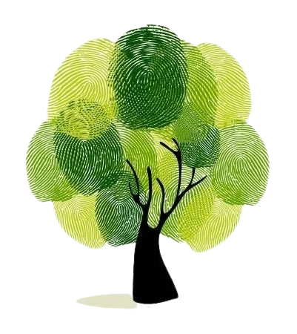
Thank you!
Thank you to my supervisor, Dr. Jurek Kolasa.
The entirety of the Kolasa lab!
Notes:
This project was incredibly exciting to work on, and cemented one of my first projects as a researcher. I would like to express my sincere gratitude to my supervisor, Dr. Jurek Kolasa, for his invaluable mentorship and guidance throughout this project and to all my lab members.
Thank you all for your attention!
Turnover = number of lost species + number of gained species
In graphs =
Patch density (total sum of inds per patch).
Species richness is grouped by patch density and averaged at each density level.
Species richness : netlogo (count unique species per patch + log as S or G), python (average richness per year and plot the mean S and G richness over time).
Relative turnover = turnover/total species
To compare variables without the bias of increased richness from species abundance, with specialists. Don’t want temporal turnover (over time), analysis to focus on habitat-driven species persistence, not time-dependent.
Mean turnover = avg turnover across all patches for each year.
Species turnover = # of appearing spe + # of disappearing spe / total # of spec observed

